Slide 1

City tours in your pocket

Slide 2


WHO ARE WE?
Guilherme
Francisco
Nordensa.com
Co-founder & Chief of staff
Siemens
Software & Connectivity Edge Developer
Heraldist
Innovation manager
UALG
Computer Science
ISCAL
Entrepreneurship Professor
+30 countries | +100 cities | +50 tours
+10 countries | +30 cities | +10 tours

Slide 3
WHY POCKET TOURS?
Everyone can become a
storyteller.
pockettours.com
city tours in your pocket
@2024

Slide 4
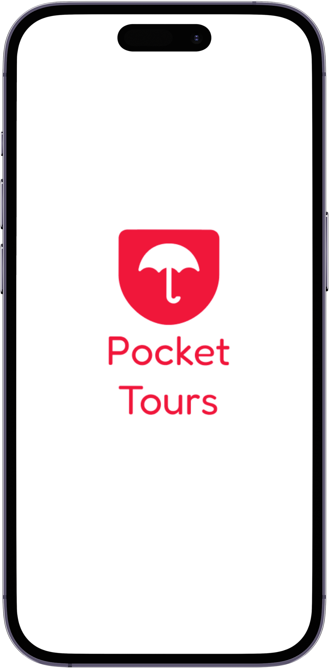
AN APP FOR EVERYONE
GUIDES
TRAVELERS
SPONSORS
pockettours.com
city tours in your pocket
@2024

Slide 5

Tourists
Weather
Conditions
Scheduling restrictions
Communication
Safety
Hit
PAUSE
!!!
You
manage
the risks
You
decide
pockettours.com
city tours in your pocket
@2024

Slide 6
Tour guides
Communication
& Safety
The runners
Dependence
Earnings
Pay before you play
Your tours, your way
Not
anymore
Unlimited
!!!
pockettours.com
city tours in your pocket
@2024

Slide 7
Digital world, no digital tours?
IF NOT US,
SOMEONE WILL DO IT.
pockettours.com
city tours in your pocket
@2024

Slide 8
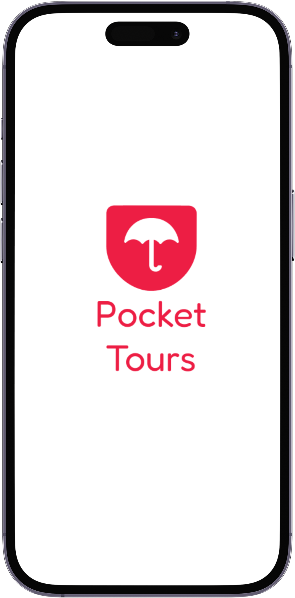
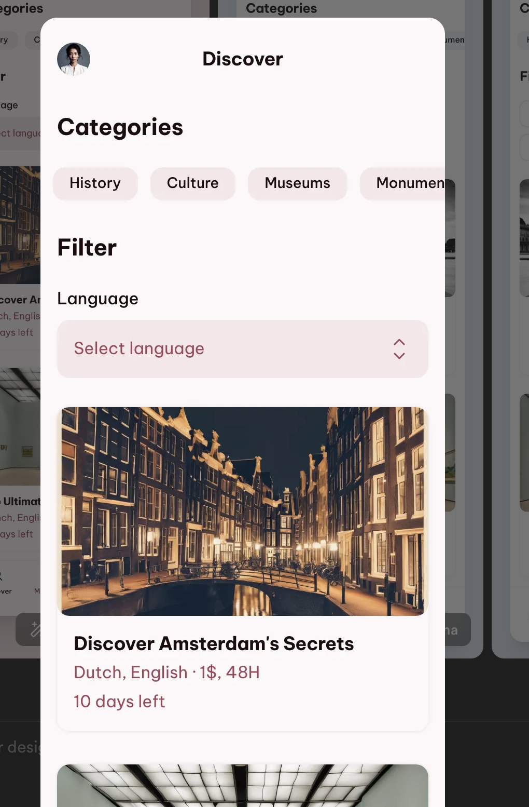
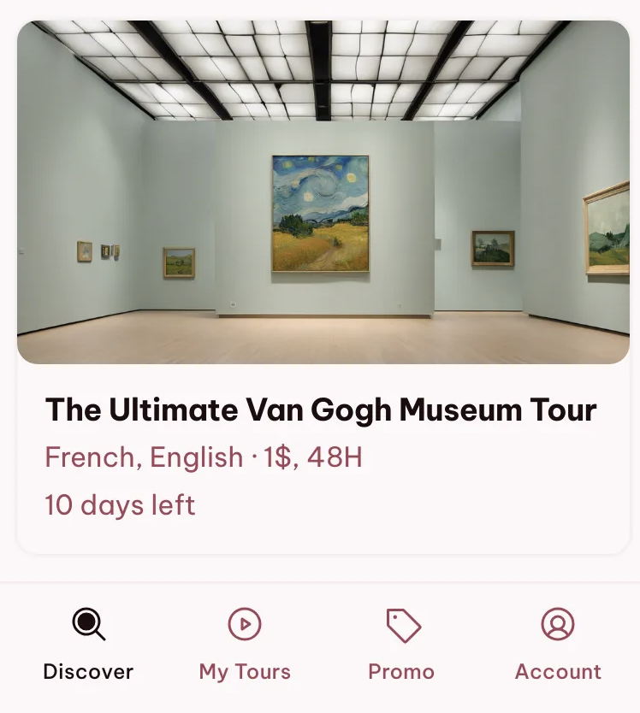
THIS IS WHY
Multiple problems SOLVED
Everyone can do it
A world of POSSIBILITIES
Sooner or later… it will happen
pockettours.com
city tours in your pocket
@2024

Slide 9
GUIDES
Individuals who create pocket tours providing informative and engaging experiences for travelers.
G
DO
Create tours
Commercialize their tours
Work for a good rating
GET
Money
Network
Feedback
Ratings
pockettours.com
city tours in your pocket
@2024

Slide 10
WHO ARE THE GUIDES?
Tours
Money
Attractions
Tips & Tricks
Independence
G
Museums
Influencing
Talking
Teaching
Outdoor
Games
Geography
History
Anna, 32
Anna, 35, is an art and history professor who’s passionate about bringing museums to life through her pocket tours, focusing on the art displayed in her hometown, Edinburgh. Thanks to Anna's pocket tours, travelers gain a deeper understanding of the artwork and exhibits, enhancing their museum experience with her expert guidance.
An archaeologist dedicated to sharing the wonders of ancient civilizations with curious travelers. He uploads pocket tours featuring in-depth explorations of archaeological sites in Rome, such as the Colosseum. Tourists visiting Rome listen to Michael's pocket tours to enrich their experience as they wander through the ancient ruins.
David, 45
pockettours.com
city tours in your pocket
@2024

Slide 11


GUIDES
EVERY GOOD REASON TO KEEP CREATING CONTENT
Be creative
Make money on your own
Marketize your work
Get rewarded
Improve with ratings and reviews
10
M
S
Top10 Paris Pocket Tours
Top Museum Pocket Tours
Top Treasure Hunt Tours
pockettours.com
city tours in your pocket
@2024

Slide 12

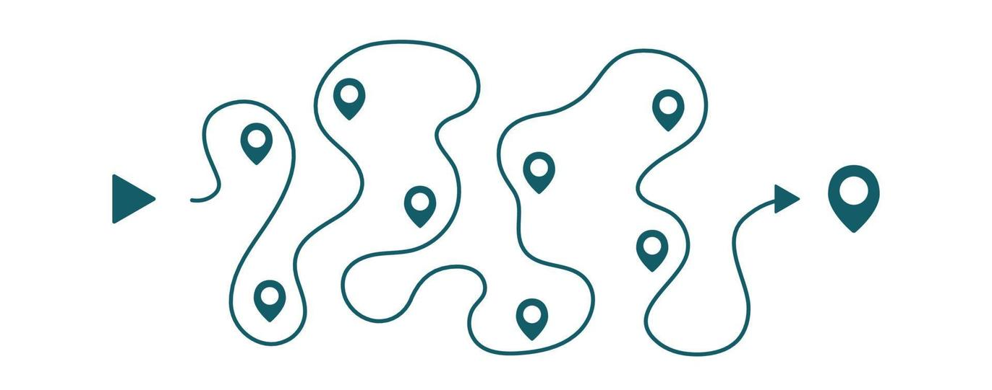


POCKET TOURS
Pick a category
(history, culture, interactive, museums, treasure hunts, night walks…)
Describe your tour
Set a path on the map
Add the audio file
Add Media
Recommendations
(souvenirs, food, monuments, other tours…)
Set time
Set price
Set discounts
Hit share!
pockettours.com
city tours in your pocket
@2024

Slide 13
GUIDE’S REVENUE
The subscription fee is only taken from guides after they make money.
No entry fees.
 | Guide | Pocket Tours
First 5€ of revenue/month | 0% | 100%
After that | 90% | 10%
pockettours.com
city tours in your pocket
@2024

Slide 14
TRAVELERS
Individuals who enjoy audio guided exploration when travelling to a new place
T
DO
Buy tours
Share
Rate & review
GET
Multiple tours to choose from
Affordable tours
Lots of options
pockettours.com
city tours in your pocket
@2024

Slide 15
WHO ARE THE TRAVELERS?
Learning
Thrifty
Tours
Attractions
Tips & Tricks
Independence
Art
T
Podcasts
Walking
Museums
Discovering
Culture
Outdoor
Games
Geography
History
Alex, 45, is on a business trip to Rome. During his downtime, he enjoys immersing himself in the local culture and history. Luckily, a pocket tour about ancient Roman civilization provides him with valuable insights as he strolls through the city's historic streets.
Alex, 37
is a travel enthusiast who recently arrived in Tokyo for a vacation.
She's always been fascinated by Japanese history and culture, and she's eager to explore the city while learning about its rich historical background through a bunch of pocket tours made by locals.
Emma, 28
pockettours.com
city tours in your pocket
@2024

Slide 16
TRAVELER PREMIUM
 | Traveler | Traveler Premium
Price | Free | 15€/Year
Ads | Yes | No
Tour play time | 48 hours | 1 month
Listen Offline | No | Yes
High audio quality | No | Yes
Discounts | No | Yes
pockettours.com
city tours in your pocket
@2024

Slide 17
TRADITIONAL ALTERNATIVES
 | Pocket Tours | Free Tours | Traditional tours
Price | 1€-5€ | 15€-20€ | 50€-250€
Convenience | Always | Not much | Not much
Possibilities | Endless | Limited | OK
Accessibility | 2 clics, one tour | Not good | Not good
Awareness | Could be huge | Not much | Common
Safety | Great | Risky | Good
Personal contact | None | Good | Personalized
pockettours.com
city tours in your pocket
@2024

Slide 18
Competition
Traditional Tours:
Tours organized by travel agencies or specialized companies, with professional tour guides.
Advantages: They provide a guided experience with detailed information.
Limitations: High costs, fixed schedules, and lack of customization.
Ex: Civitatis; Exodus Travel; Trafalgar
Self guided Tours:
Tours where tourists explore on their own, following printed or digital itineraries and guides.
Advantages: Complete flexibility in schedules and reduced costs.
Limitations: Content limited to the number of professionals in the app.
Ex: VoxCity; Walkbox; PocketGuide
Free Tours:
Tours conducted by local guides or volunteers, usually relying on tips.
Advantages: Accessible for travelers on a limited budget.
Limitations: Variable quality and consistency, dependent on the availability of guides.
Ex: Guruwalks; SANDMAN’s; Walkative
Pocket Tours:
Tours em que os turistas exploram por conta própria, através de uma app.
Vantagens: Flexibilidade total de horários; custos reduzidos; conteúdo ilimitado e personalizável.
Limitações: Pode tornar a experiência de fazer tours mais impessoal por não ser presencial.
pockettours.com
city tours in your pocket
@2024

Slide 19
MODERN ALTERNATIVES
 | Pocket Tours | Self Guided Tours
Price | 1€ - 5€ | 3€ - 20€
Possibilities | Endless | Limited
Tours available | Endless | Limited
Brand Reach | None, for now | Close to none
Ads | Yes | No
pockettours.com
city tours in your pocket
@2024

Slide 20
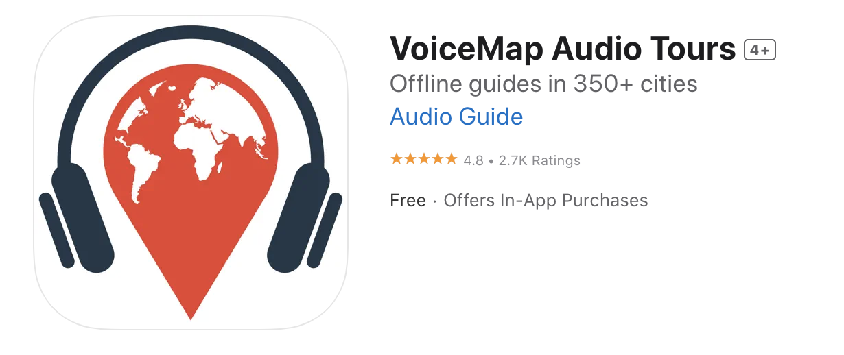










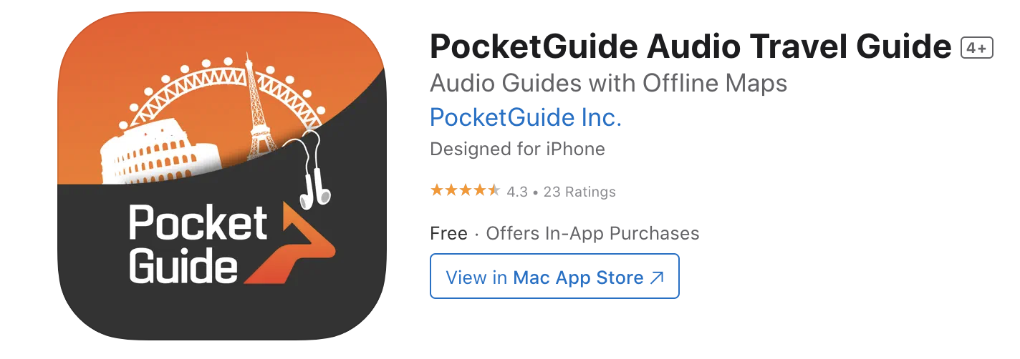


MARKET’S ALTERNATIVES
Walking
B2C
Driving
pockettours.com
city tours in your pocket
@2024

Slide 21
SPONSORS
Companies looking to advertise on tours
S
DO
Advertise on tours
Offer discounts to travelers
GET
Targeted advertising opportunities
pockettours.com
city tours in your pocket
@2024

Slide 22
TARGETED MARKETING
Targeted
marketing
for
SMEs
pockettours.com
city tours in your pocket
@2024

Slide 23

TARGETED MARKETING
Lisbon Souvenirs
Pastéis de belém
Mosteiro dos Jerónimos
Sodré Restaurant
pockettours.com
city tours in your pocket
@2024

Slide 24
BUSINESS MODEL
20%
From every tour sold on the app
5€
Monthly subscription from Guides
15€
Traveler Premium Subscription
Ads
Running on the app
€
Highlighted tours
pockettours.com
city tours in your pocket
@2024

Slide 25
Product Features
Y1
Q1
Q2
Q3
Q4
Dev | Alpha Stage
Beta Stage
Launch
pockettours.com
city tours in your pocket
@2024

Slide 26
Product Features
Y1
P1
P2
P3
P4
Sign in/ Log in
Account
Profile
Settings
Search tours
Play tours
Upload tours
My tours page
Tours page
Payment system
Location
Feedback
Wallet
Rate and review
Stats page
My ratings and reviews
Account verification
Promocodes
Referrals system
Geotargeting
Sign in/ Log in
Account
Profile
Location
Ongoing tour widget
History page
Create bundles
Guide Badges
Highlight tour option
Chats
pockettours.com
city tours in your pocket
@2024

Slide 27
Financials
Marketing
38.150€
Business
87.818€
Product development
97.320€
Total
225.000€
pockettours.com
city tours in your pocket
@2024

Slide 28

Business Roadmap
Business Plan,
Financial Forecast
Product Dev
Seed Round
Concept
Market Research
Team
Launch in Europe
Pre Seed Round
pockettours.com
city tours in your pocket
@2024

Slide 29
Thank you
pockettours.com
city tours in your pocket
@2024

Slide 30
pockettours.com
city tours in your pocket
@2024

